Slide 1

Abusive Language Detection
Vishnu Vardhan Reddy Yeruva

Slide 2
Introduction
With the increase in the culture of social media and social networking sites, the use of abusive language has increased rapidly.
Abusive language can be expressed as dirty words in conversation (oral or text)
Every day, millions of comments are posted on the uploaded posts. Abusive language in online comments initiates cyber-bullying that targets individuals

Slide 3
How to Tackle
There are many algorithms in ML and DL to deal this problem programmatically.
There is an issue even with this i.e. all of the ML and DL algorithms that are available as LSTM, CNN are only possible with English as there is lot of rich resources available.
This paper includes the description of an application that helped in one of the very rare language like URDU. That means it even can help any other language using CNN

Slide 4
Challenges
Text classification using DL models has several advantages over conventional ML models.
The main challenge for ML models is that their performance is dependent on feature selection methods, Several studies conclude that there is no universal feature selection method that works well with all types of ML models.
Hidden layers within a DL model extract the useful features automatically. It is difficult to observe which features are chosen for a specific task.

Slide 5
Steps to approach
Exploring the performance of DL models to detect abusive language from online comments.
Empirically investigating the performance of these models on two popular scripts of the Urdu language: Urdu and Roman Urdu.
Exploring the architectures of RNN models having one-layer and two-layers of hidden units.
Comparing the performance of DL models with ML models to detect abusive language.

Slide 6
Learning Technique
ensemble learning technique was applied to classify abusive text collected from web pages.
three ML models decision tree (DT), NB, and SVM were used to classify abusive and non-abusive text of the Indonesian language from social media.
Similarly, n-grams techniques were applied to extract features from Arabic comments, and then ML models were used to classify these comments into abusive or non-abusive labels.

Slide 7
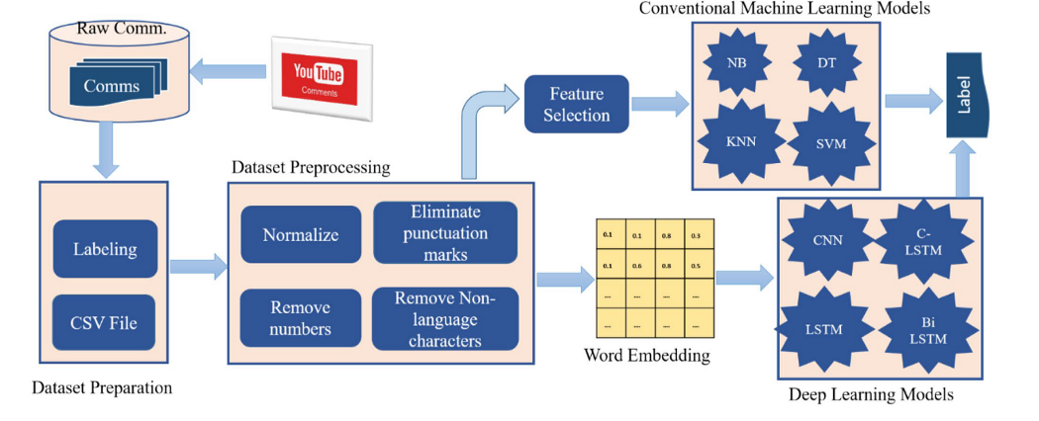
Architecture

Slide 8
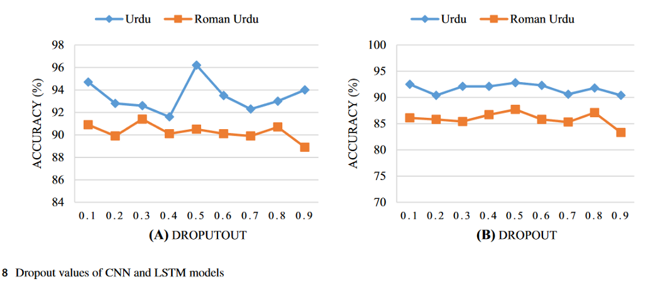
Comparison

Slide 9
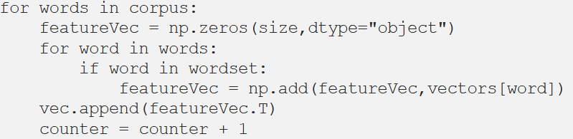
Model Training
Wordset = set(vectors.wv.index2word)
This checks whether the word is in Word2vec (a library) corpus (set of words) or not
If word is in the dataset reporting it as abusive. And lopping it continuously by incrementing counter in order to find the number of abusive words

Slide 10
Real-Time
In real time while running the application it get’s the data automatically updated with json file as an URL request
In return it responses back the list of prediction of abusive and non abusive with count.
The response will have a key uuid which will have the same uuid which was provided in the url

Slide 11


